Slide 1
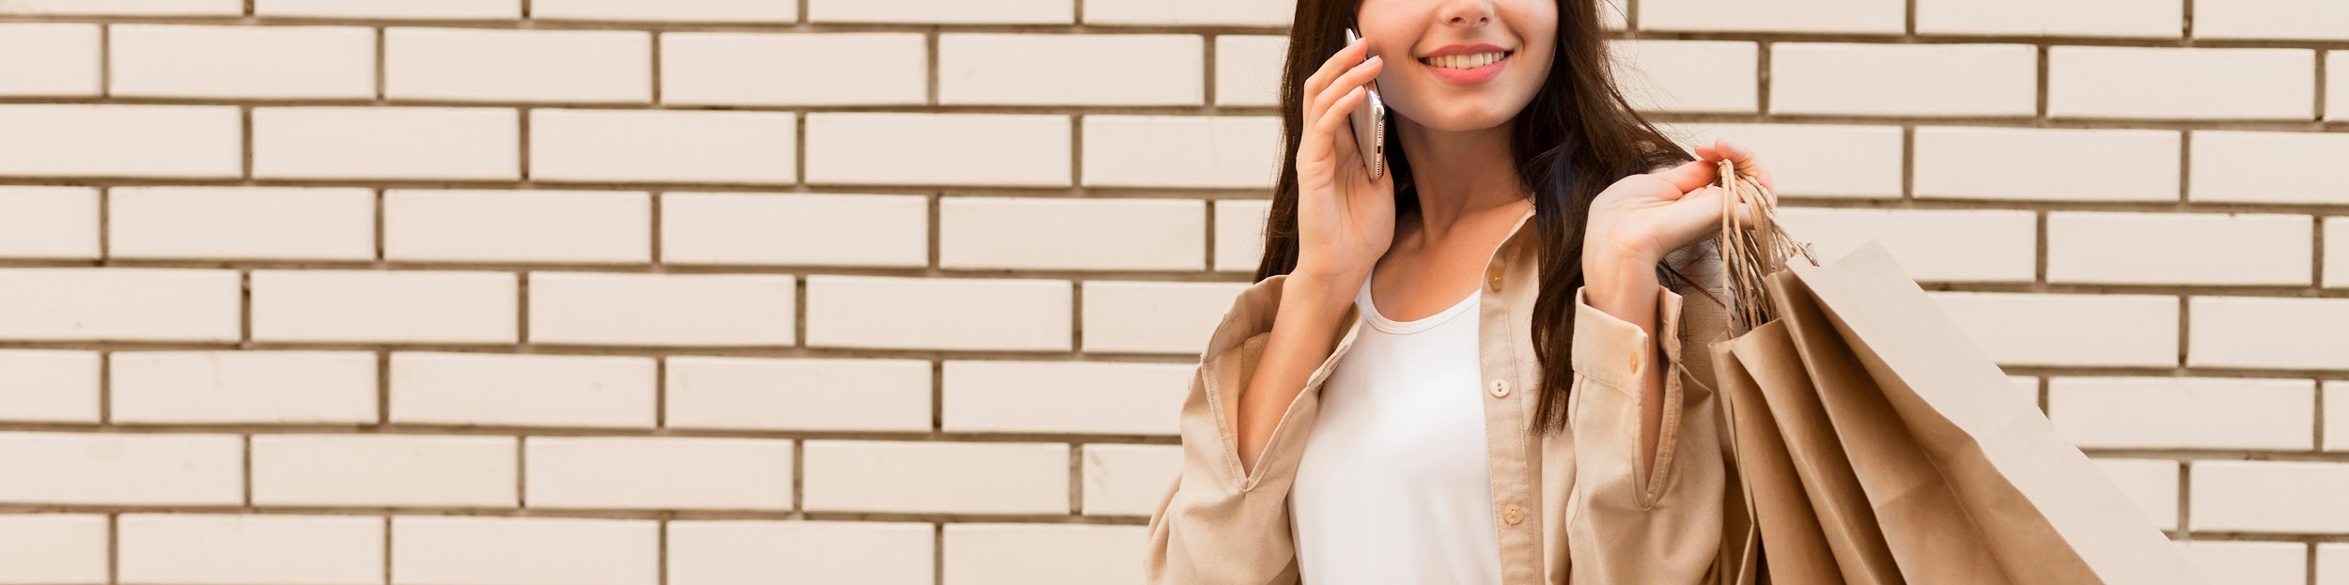
Fashion trends presentation
Fashion Dataset UK-US
Presented by Team 1- The Nexus League
(Jeffrey Robertson, Neel Chunara, Shelly Girdhar Sakkerwal, Ruby Landry)

Slide 2
About Dataset
Key Attributes
Mimic the real sales process in the fashion industry: This dataset provides valuable insights into the dynamics of the fashion market and serves as a reliable resource for analyzing sales trends, forecasting demand, and optimizing business strategies.
Collected and updated on a weekly basis: The Fashion Sales Dataset encompasses a wide range of attributes that capture the intricacies of the fashion market. It offers a realistic representation of sales transactions, customer preferences, and product characteristics, enabling researchers, analysts, and industry professionals to gain deep insights into consumer behavior and make informed decisions.
Source:Kaggle
Realistic sales process
Diverse attributes - Product, Price, Brands, Style attributes,Categories, Season
Mimicked customer interaction: Feedbacks, Ratings, Reviews
Seasonal and Time variation

Slide 3
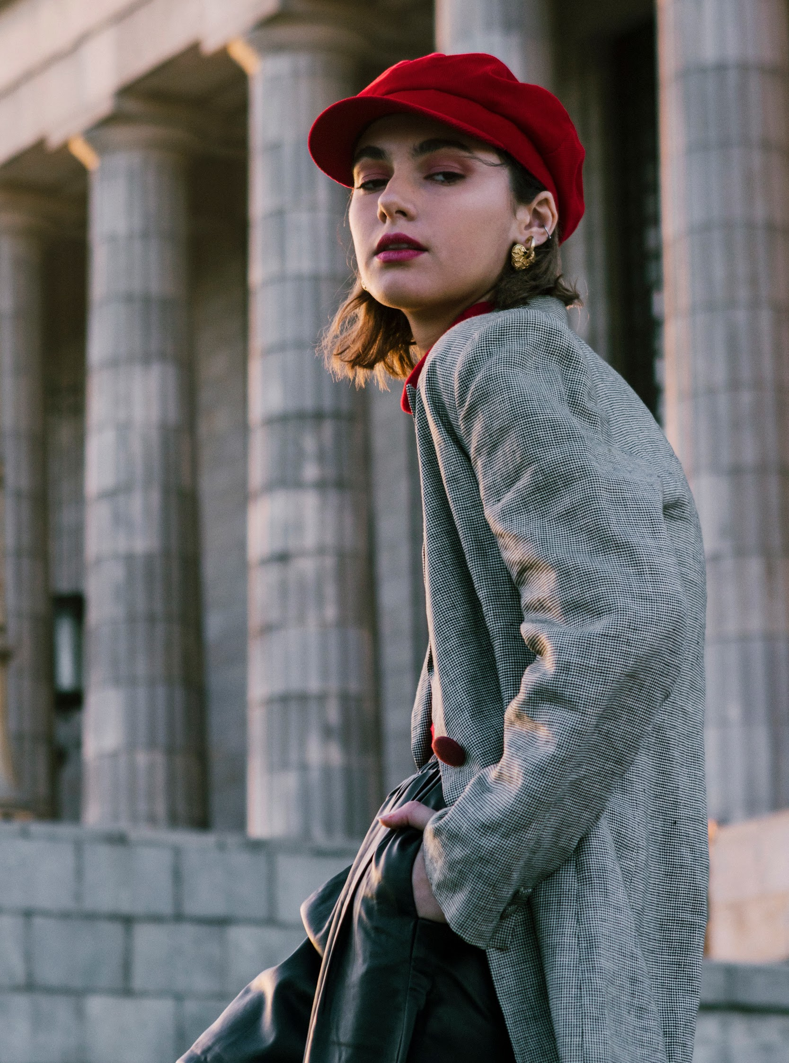
Industry Dilemma
Is there any correlation between age and the time period highest purchases?
Any correlation between the age of consumer and the influencer?
Is there any correlation between higher price products have higher rating?
Does age impact how people are influenced by social media?
Is there a relationship between Brands, Customer Reviews, Social Media Comments, Feedback, and sales?
Do style attributes change as per the season? - to understand the consumer preference
Is there a correlation between the colours of clothes and the season? - to understand the consumer preference
Is there any correlation between sizes purchased by brand or style? - to understand the consumer

Slide 4
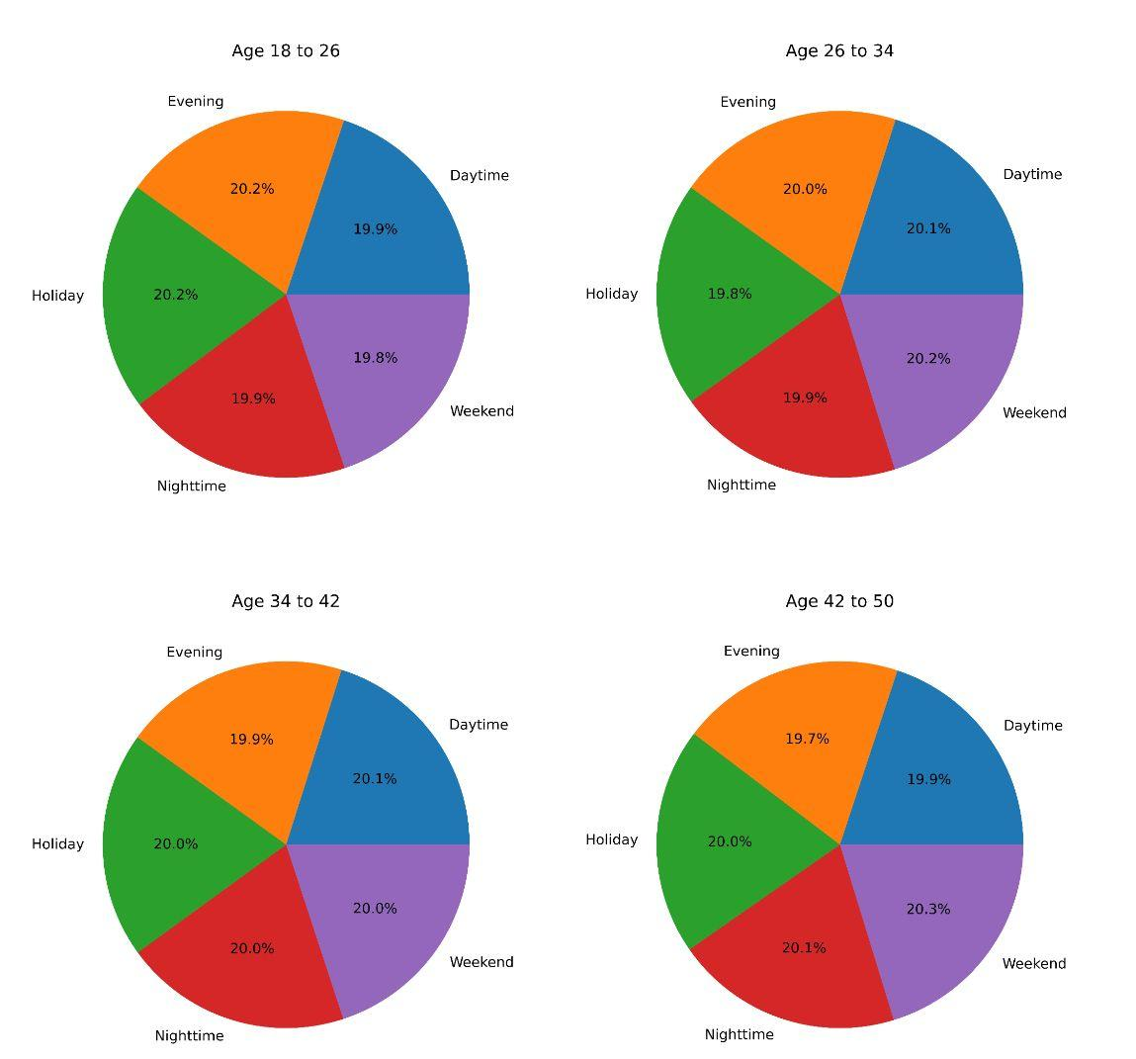
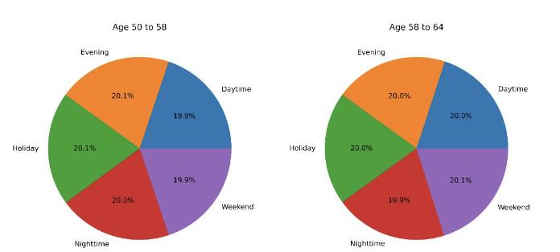
Shopping Habits Based on Age

Slide 5
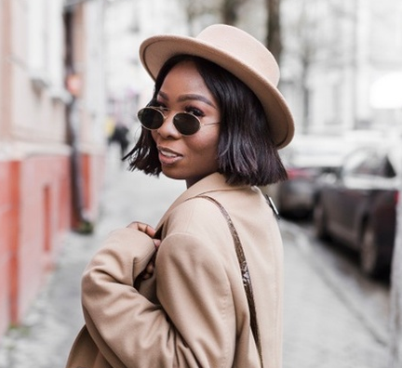
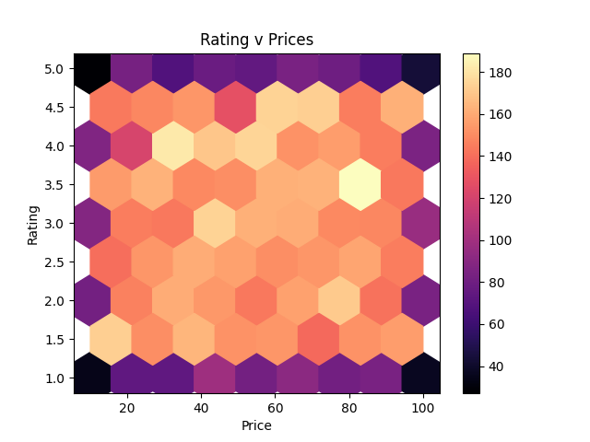
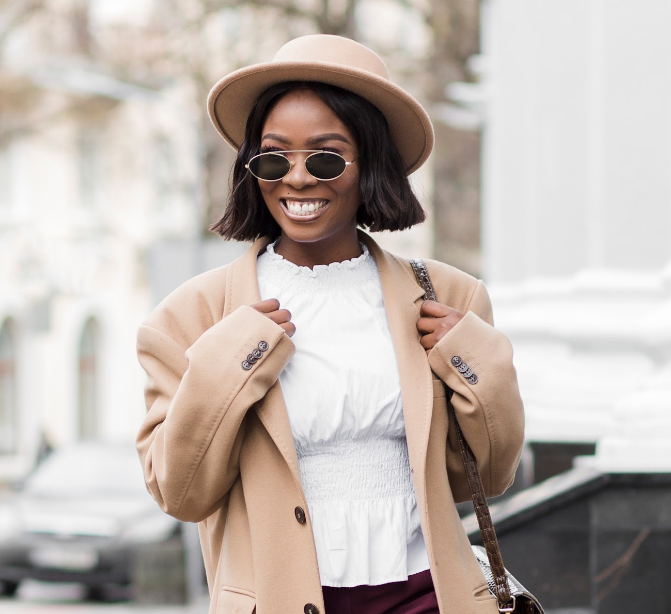
What About Relation Between Price and Rating?

Slide 6
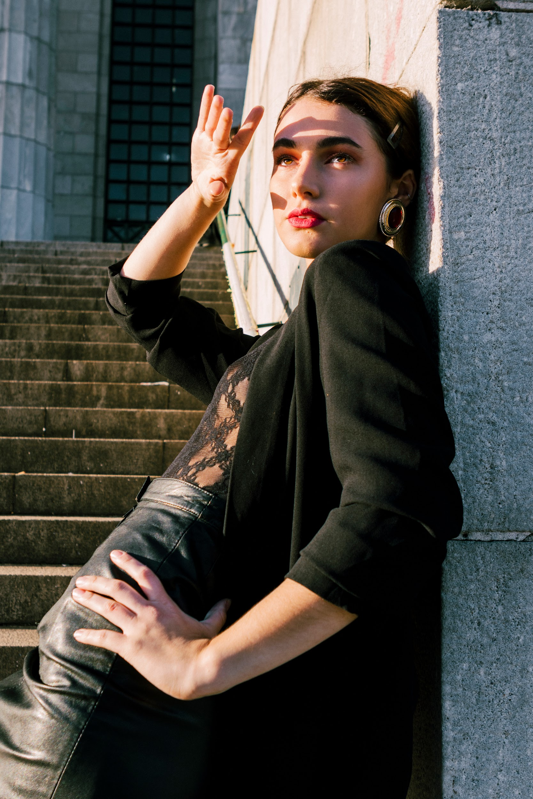
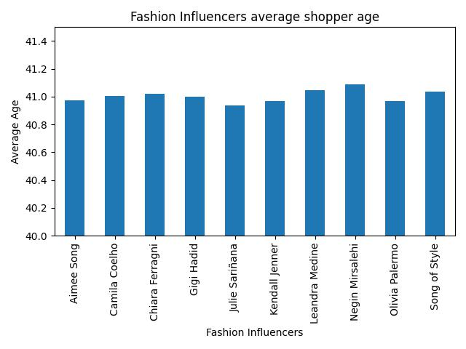
Fashion Influencers & Average Age of Shopper

Slide 7
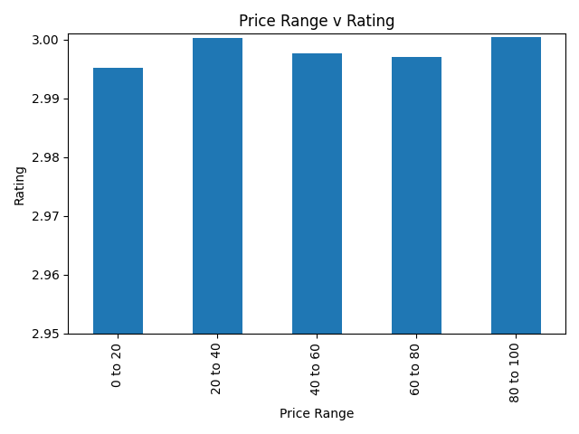
Price Relation With Rating

Slide 8
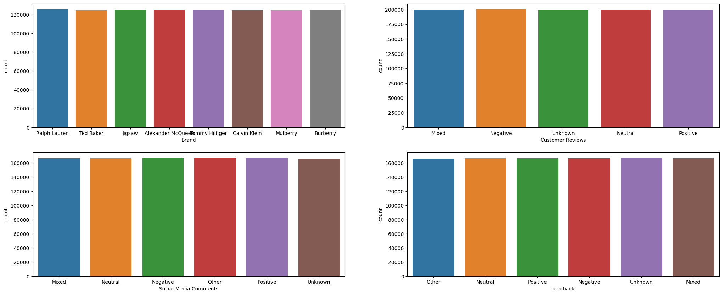
Brand vs Customer Reviews vs Social Media Comments vs Feedback

Slide 9
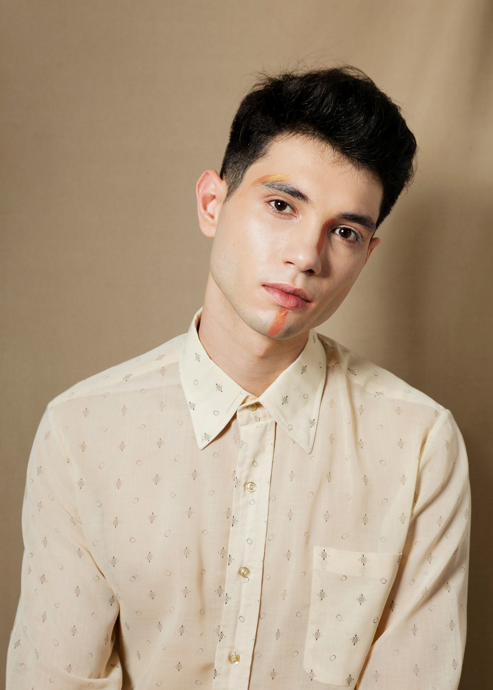
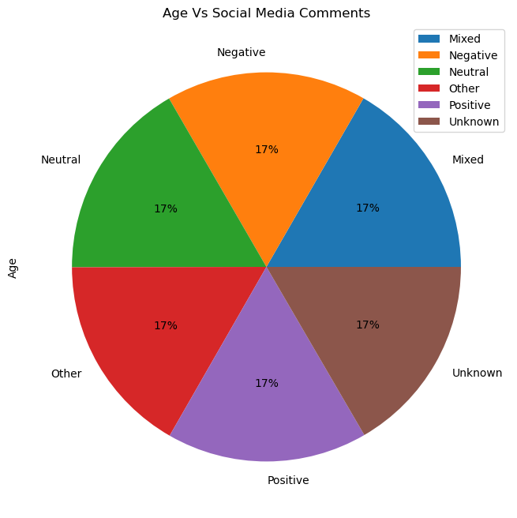
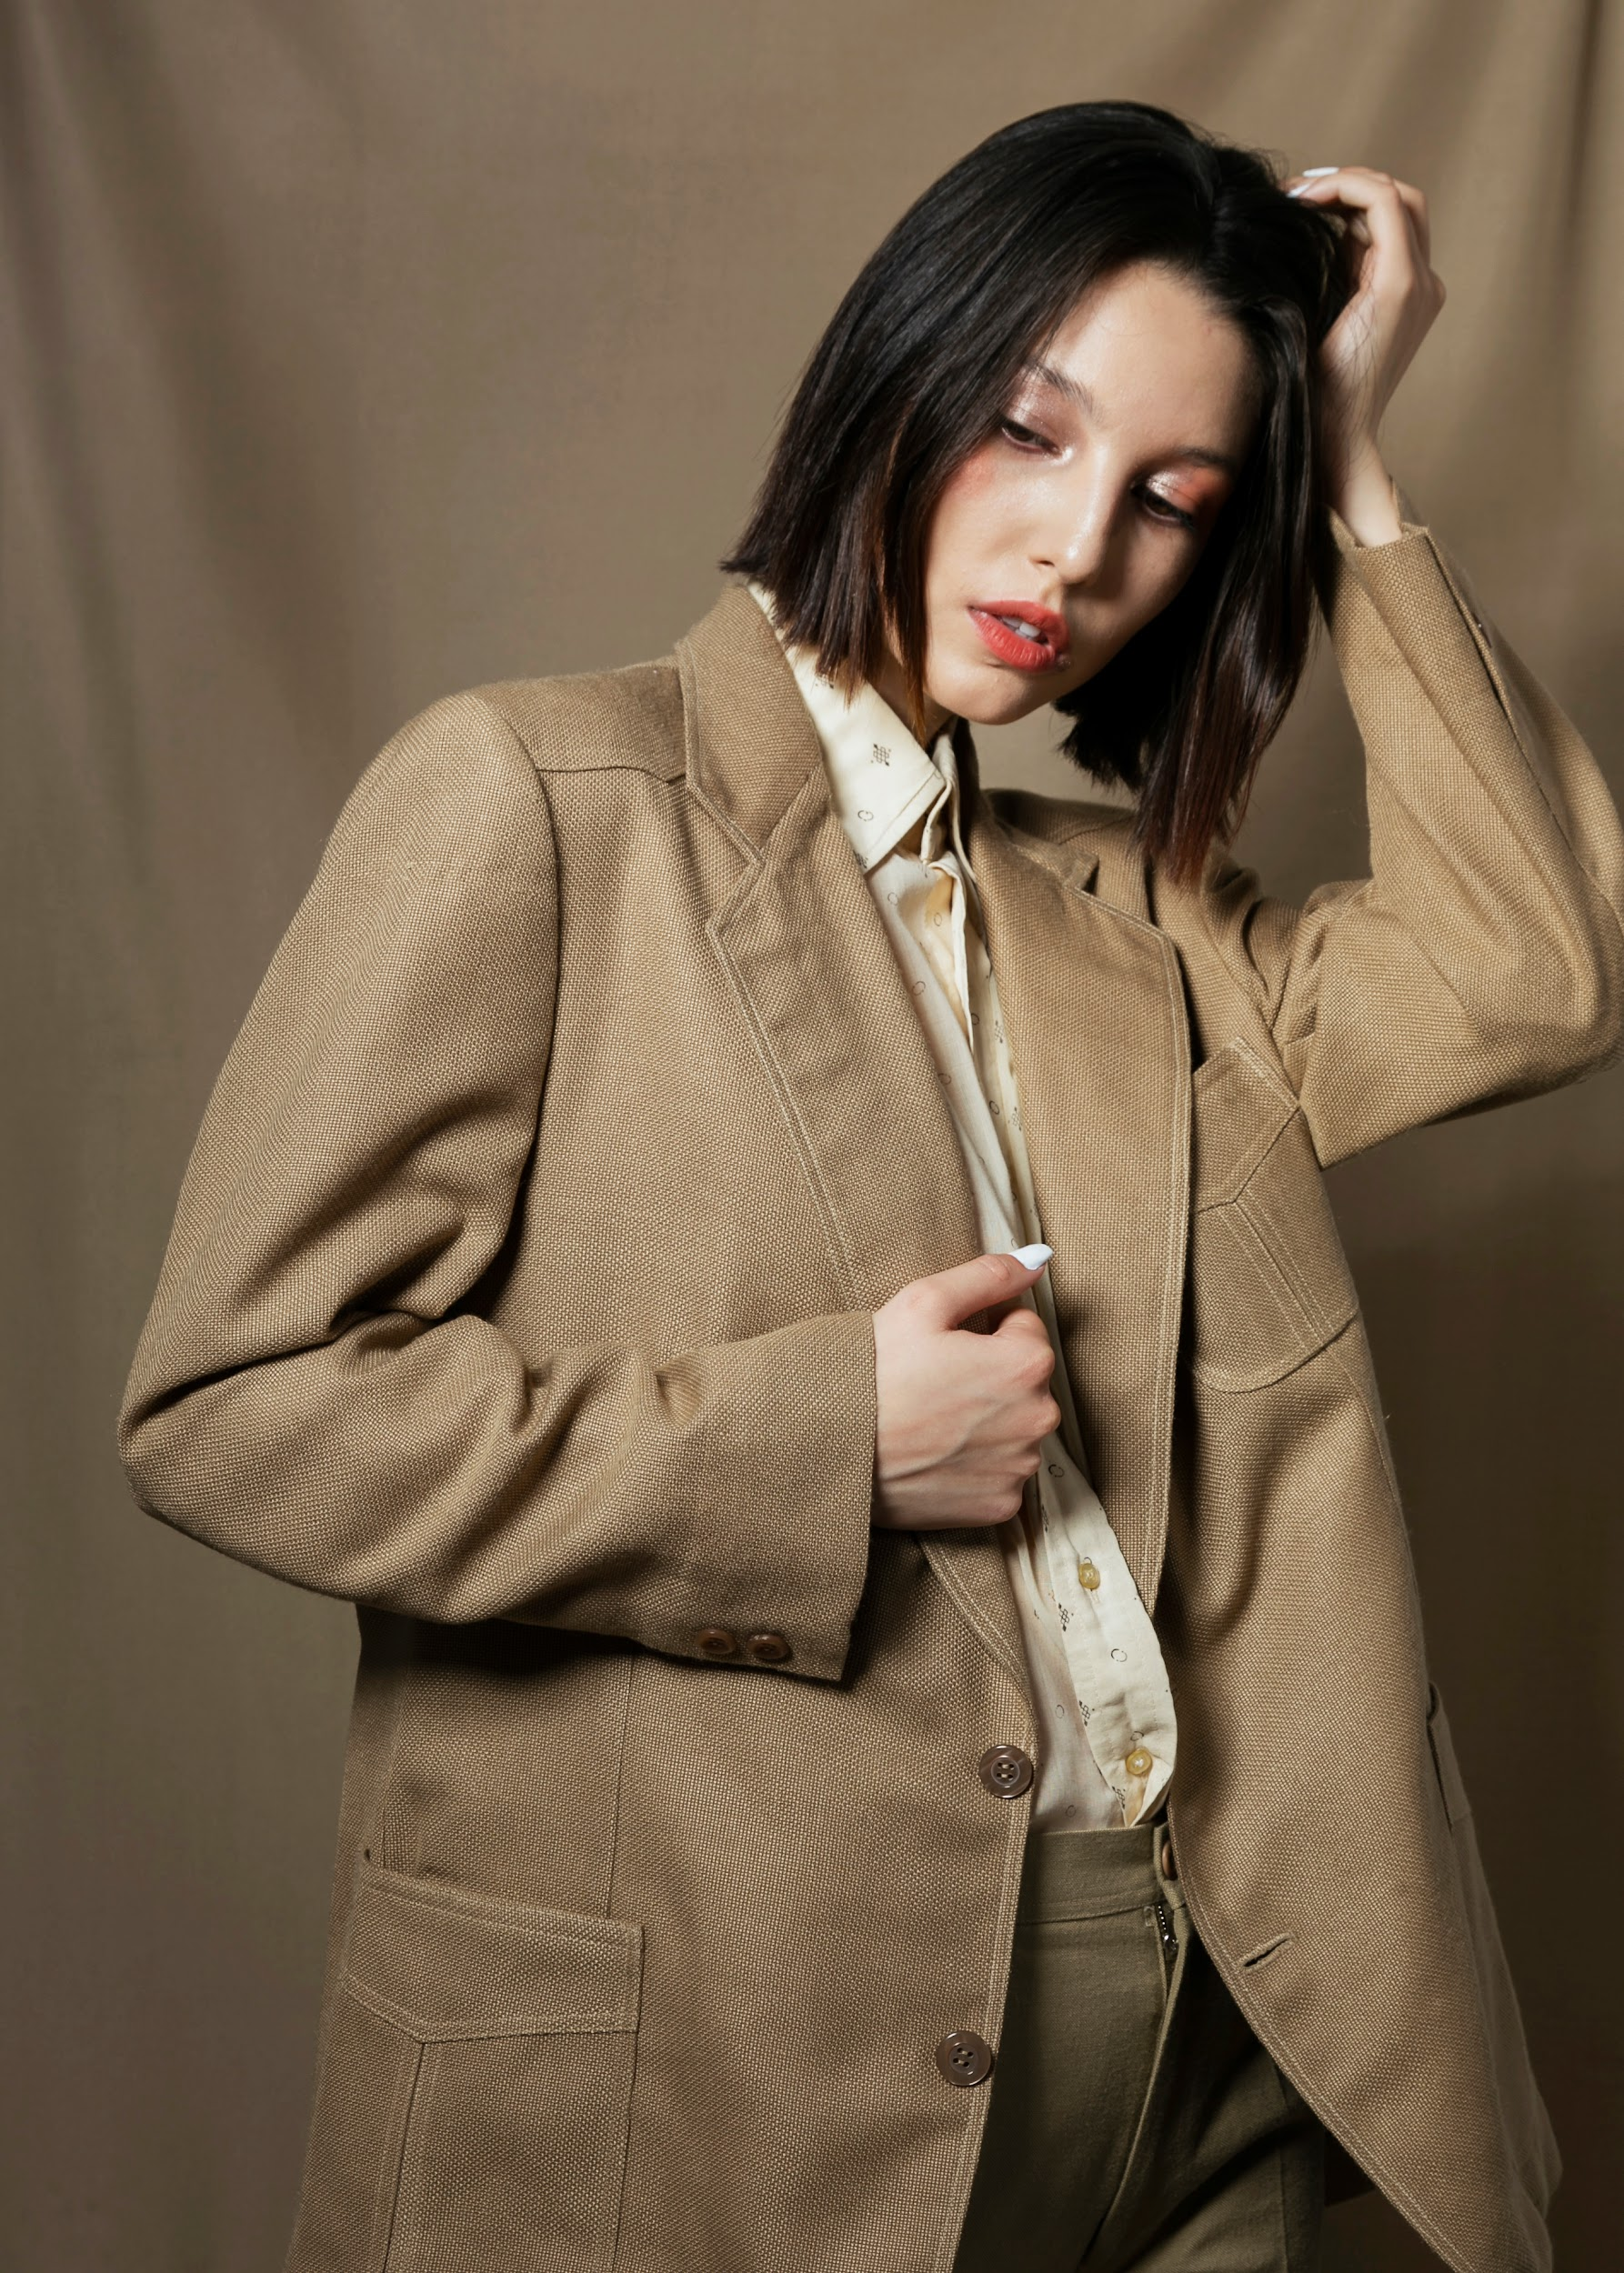
Age Vs Social Media Comments

Slide 10
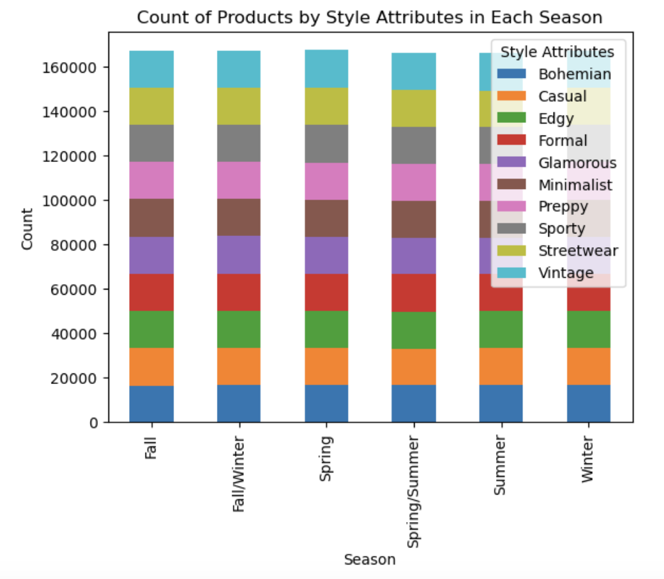
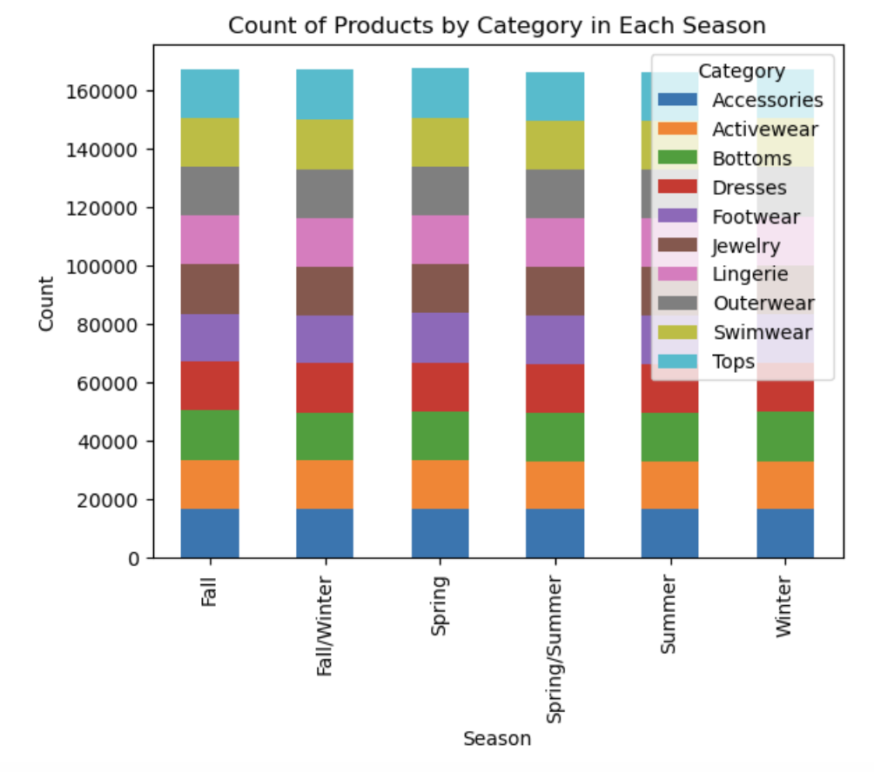
Seasonal Trends - Style Attributes & Category

Slide 11
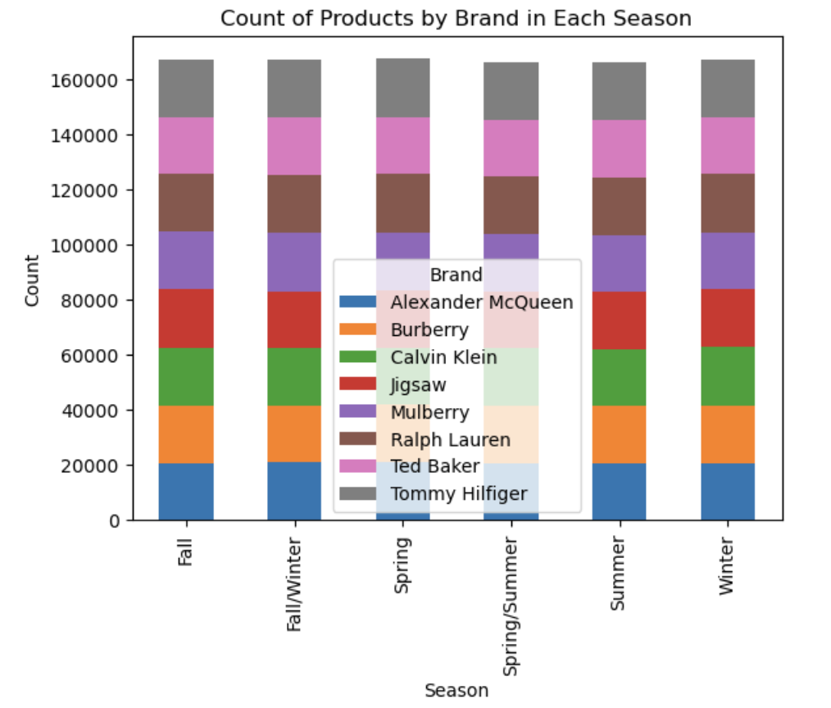
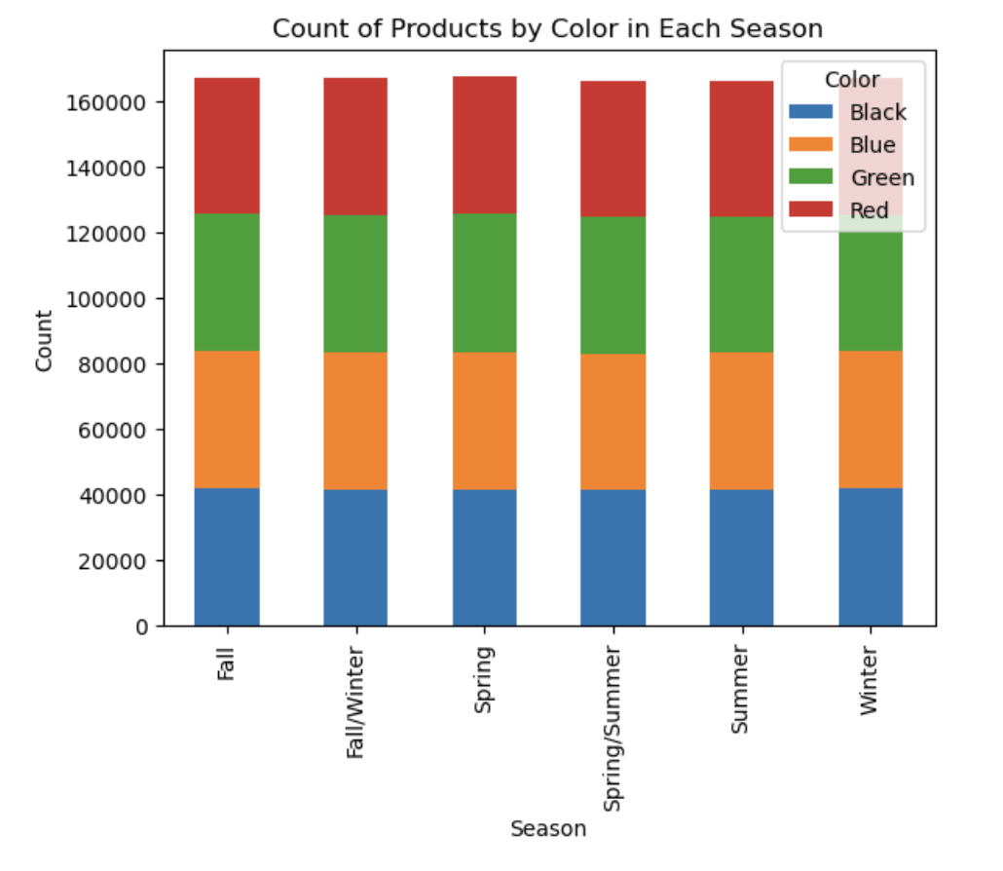
Seasonal Trends - Brand & Color

Slide 12
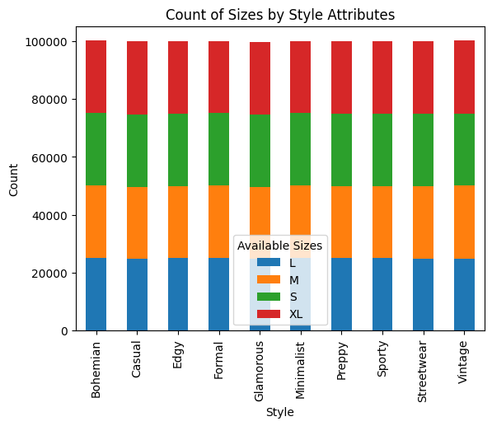
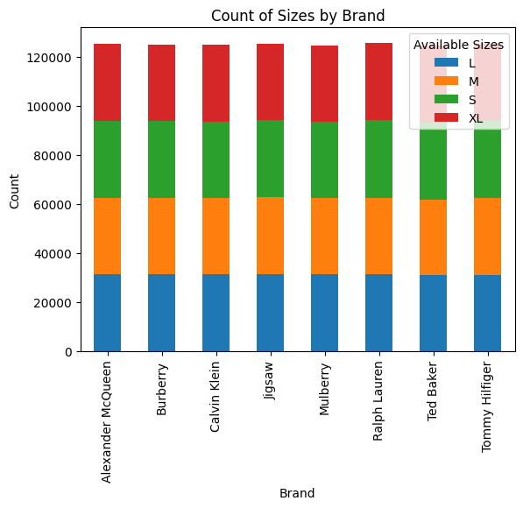
Size Trends by Style & Brand

Slide 13
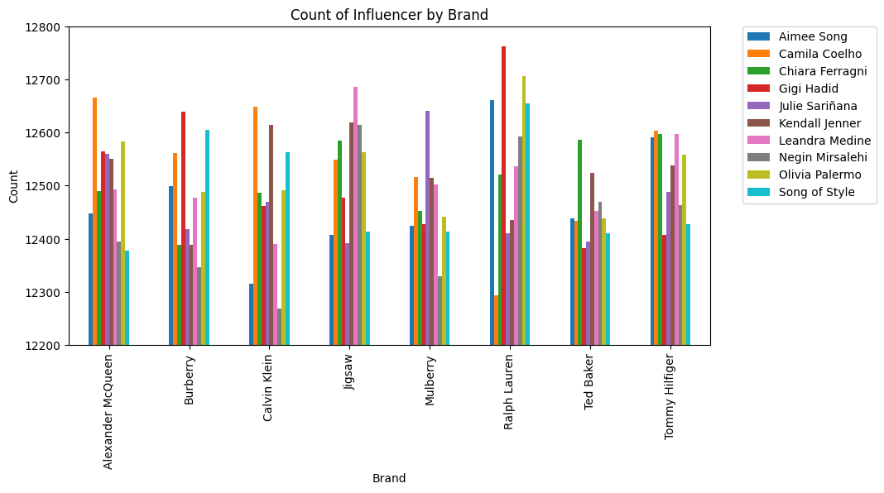
Influencer & Brand Relationship

Slide 14
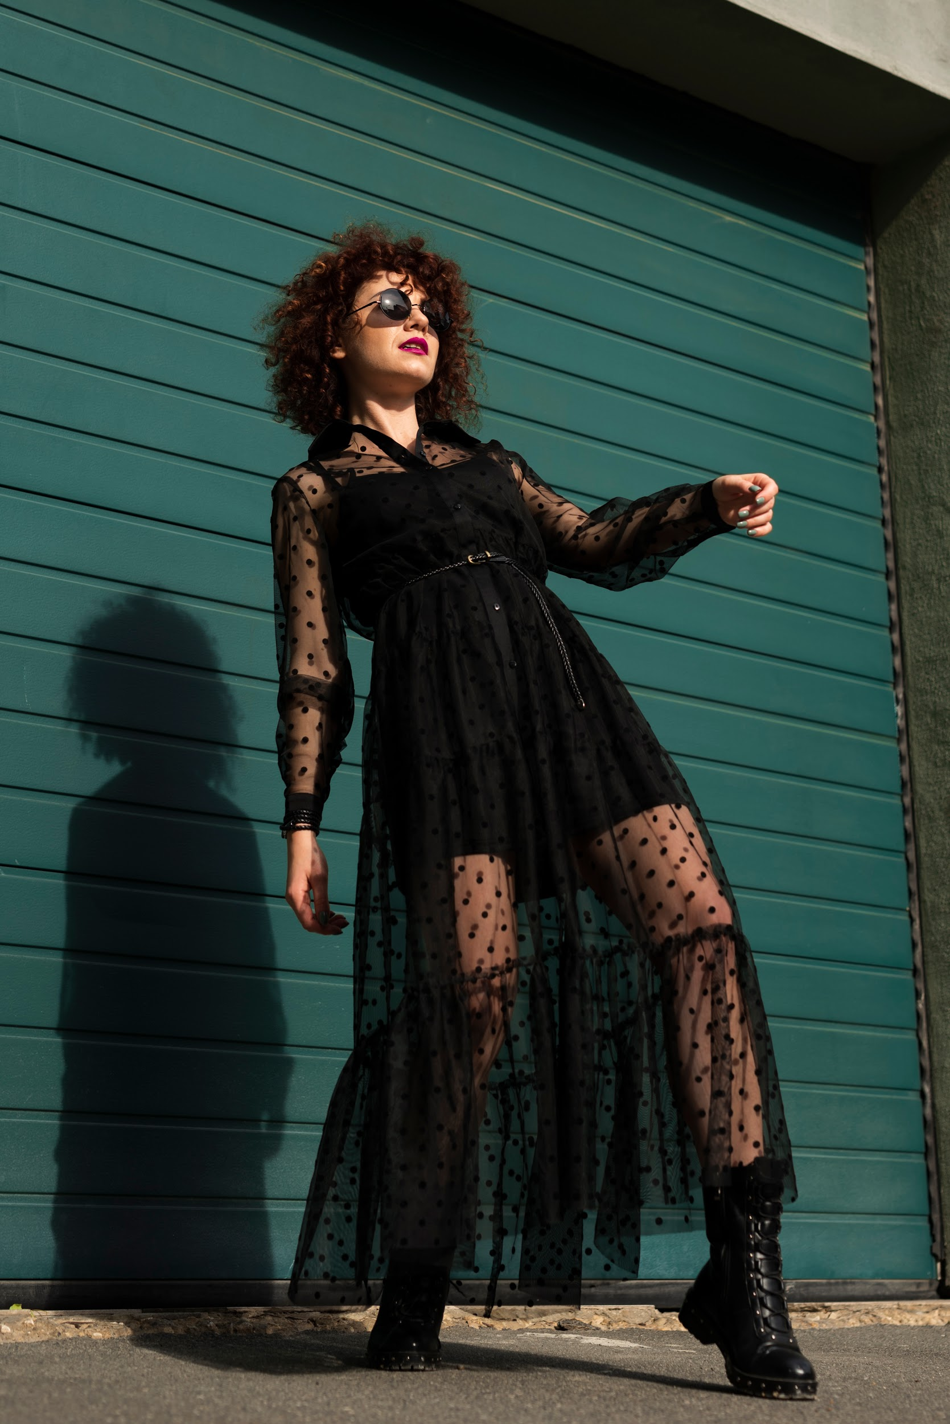
KEY INSIGHTS
The analysis aimed to uncover correlations between fashion trends and consumer purchasing behavior by examining customer reviews, social media comments, and purchase history.
Seasonal sales trends for specific styles, colors, product types, and brands were analyzed based on the number of products purchased and total sales in each category.
Consumer purchasing behavior was studied by looking at the time periods consumers shopped based on their age and the relationship between customer age and influencers.
Sizing trends for specific styles and brands were analyzed to better understand consumer and purchasing behaviour.
Big numbers catch your audience’s attention
Limitations of Dataset:
Through all of our analysis, we found that the data was very evenly spread, which likely does not reflect what would be seen in real world fashion trends

Slide 15
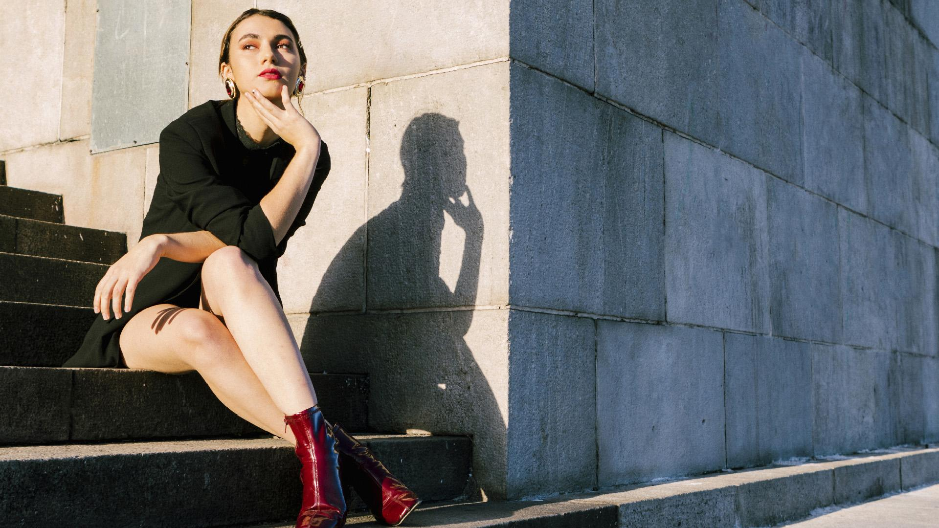
Awesome words
AS A CONSUMER WE HAVE SO MUCH POWER TO CHANGE THE WORLD BY JUST BEING CAREFUL IN WHAT WE BUY
EMMA WATSON

Slide 16
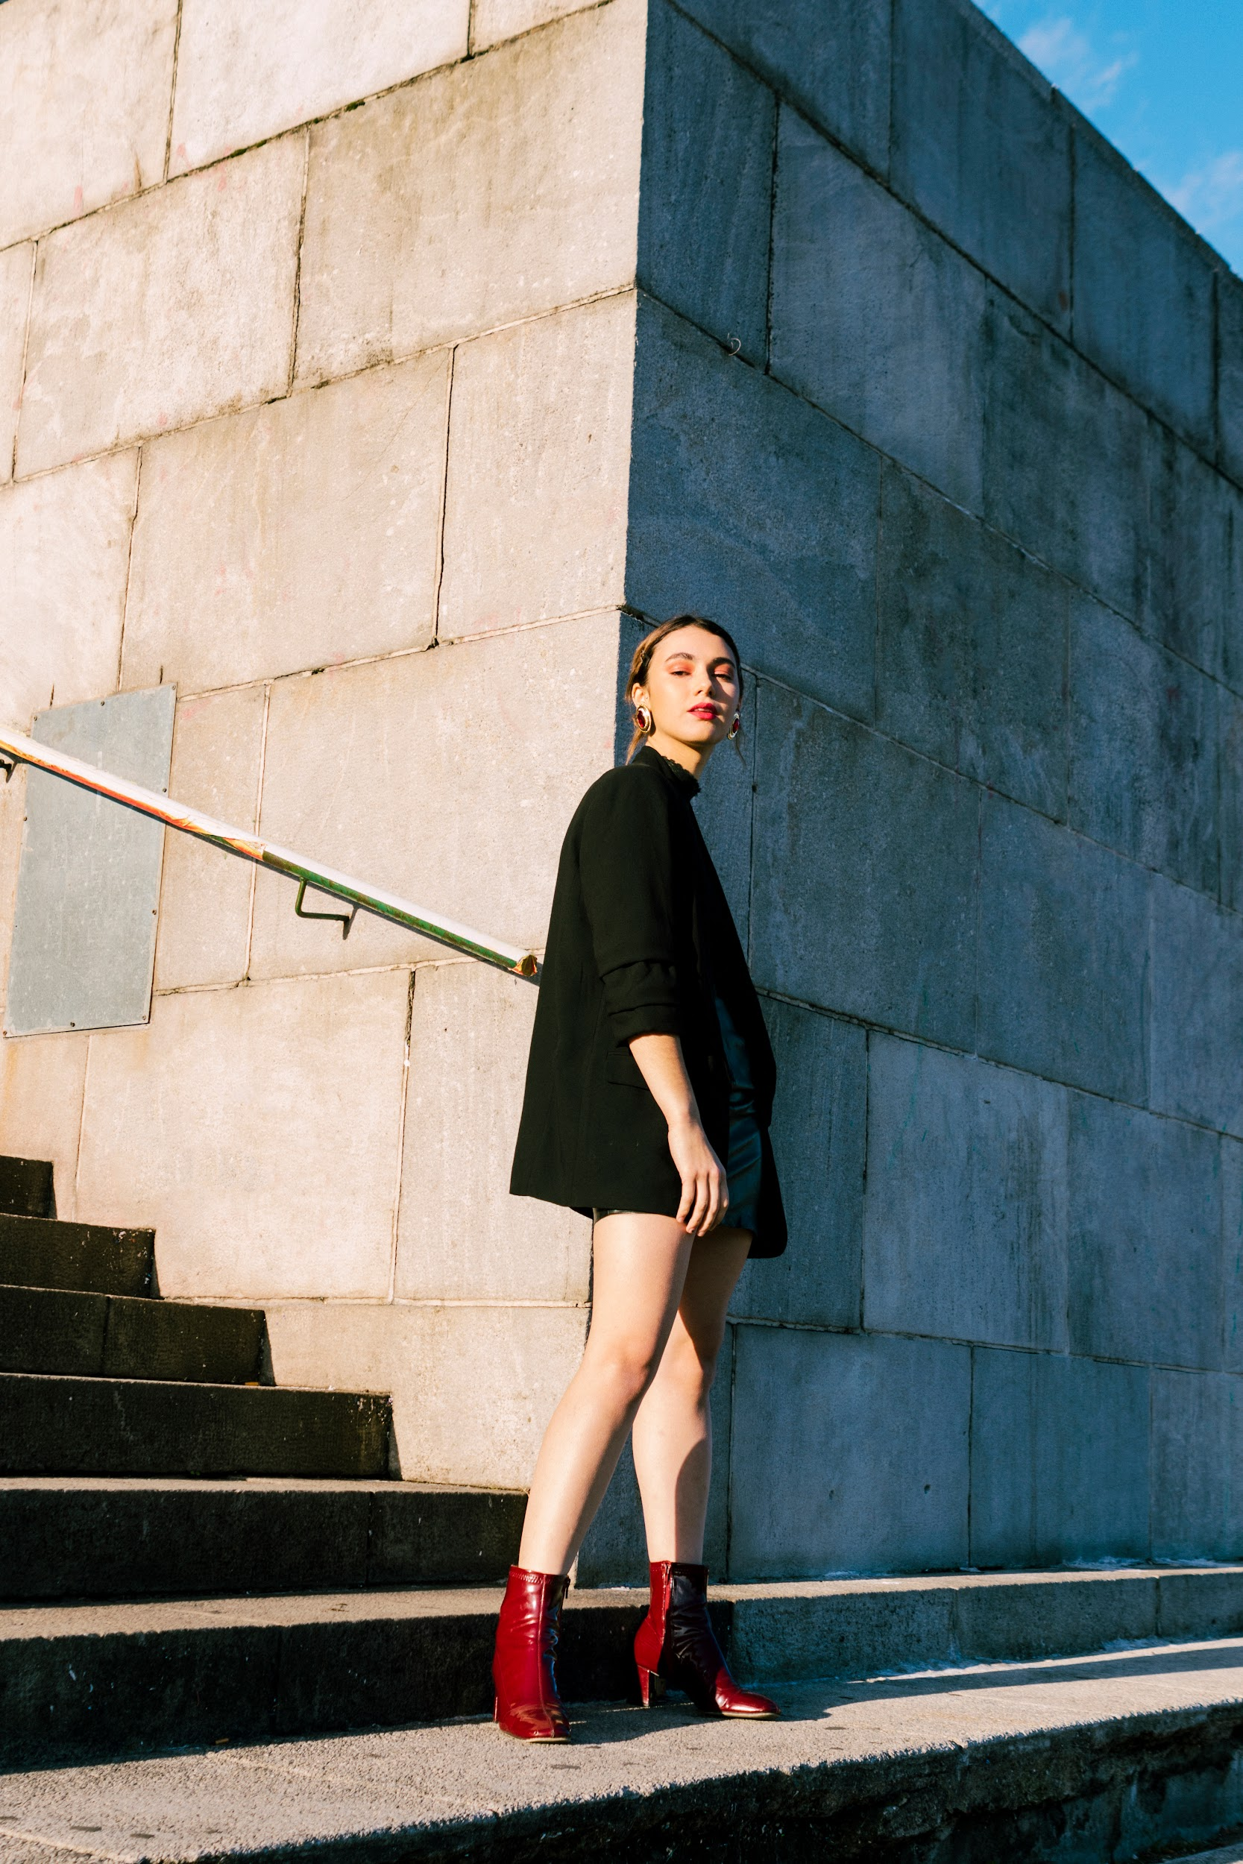
Thanks
Do you have any questions?
Please keep this slide for attribution

